Slide 1
Performance Analysis, Visualization and Big Data Solutions

Slide 2
What is Big Data
Big data is not about the data -- Gary King (Harvard)
There were 5 exabytes of information created between dawn of civilization through 2003, but that much information is now created every 2 days –Eric Schimdt (google)
Errors using inadequate data are much less than those using no data at all – Charles Babbage

Slide 3
UNIFIED DATABASE
VISUAL EXPLORATION OF TRENDS
EASE OF MODEL DEVELOPMENT
REALTIME IMPLEMENTATION
THIRD PARTY HOOKS

Slide 5

Traffic Management
Data Quality Assurance
Long/Short Term Decision – Policy
Real Time Decision Support
Probe Data
Mobility
Traffic Risk Prediction
Work Zone
Point Detector Data
Information Dissemination
Performance
Report

Slide 6
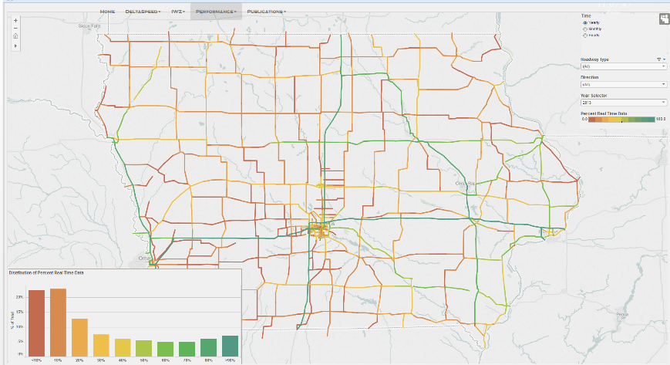

Slide 7
Latencies
Freeway
Non - Freeway
Likelihood
Latency (minutes)
Get Corresponding probe and Benchmark Data
Extract Short, Medium and Long-term trends
Calculate the similarity between trends
Similarity Measure > = Threshold
Estimate latency between dataset
Yes

Slide 8
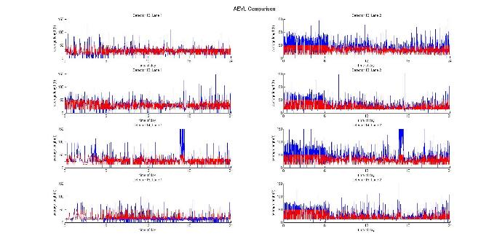
Example-Four Sensors on I-35
Average Length Computed by Traffic Flow Theory (Blue) and Vehicle Class Count Data (Red)
Lane 1 Lane 2

Slide 9
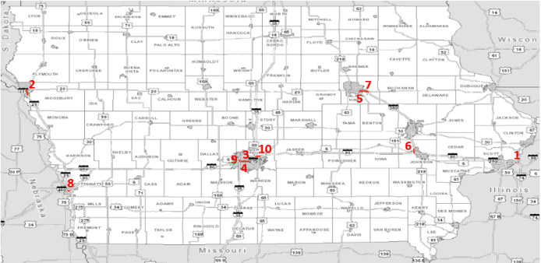
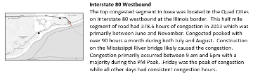
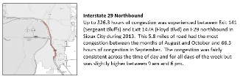
Top 10 Most Congested - 2013

Slide 10
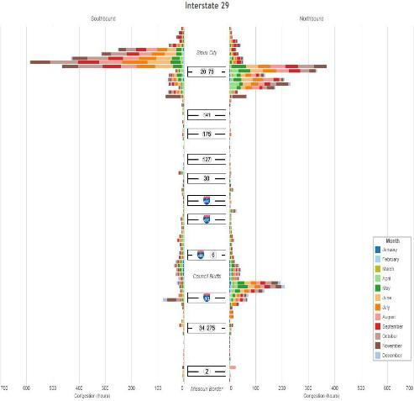
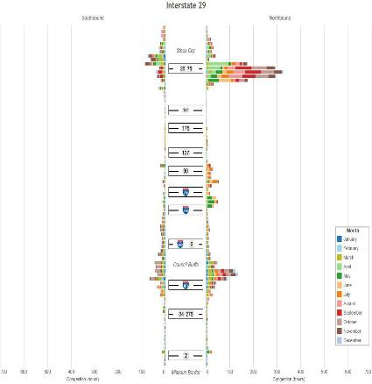



Slide 11
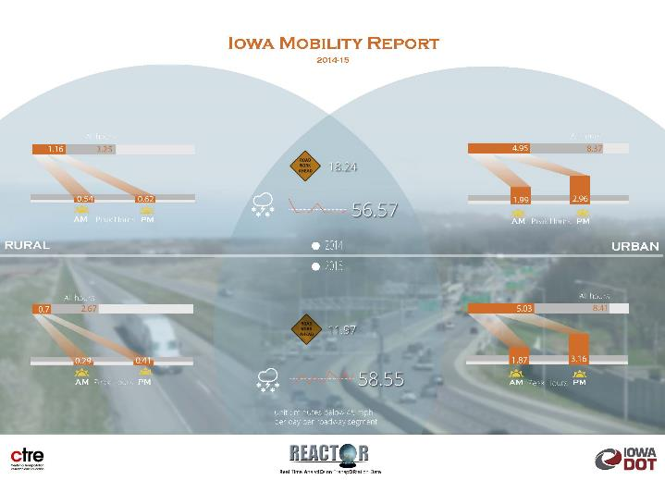

Slide 12
TCPs 2016
Notes:
18 TCPs 2016 with red pins showing the locations
Blue dots show the radar sensor.

Slide 13
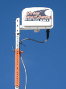
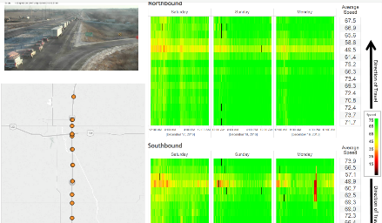
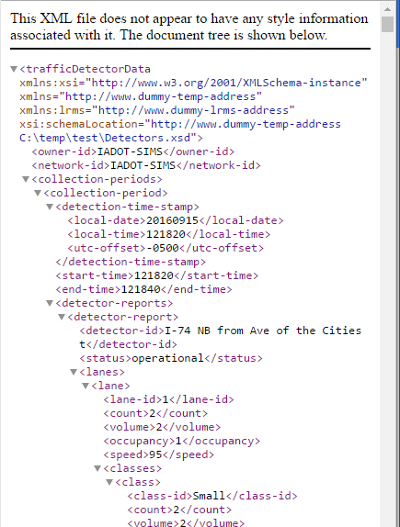
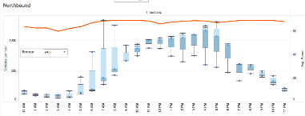
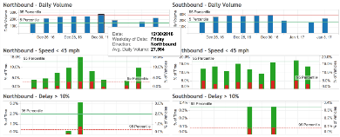
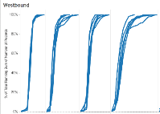
Transition
Notes:
The goal of our project is to transform the raw sensors data into an daily-auto-updated interactive visualization tool which provide both spatial-temporal traffic information and various work zone performance measures.

Slide 14
Data Pipeline
Weekly
Streaming Sensor Data
Hadoop Distributed File System (HDFS)
Column-Oriented Database
Tableau Online
PDF Document Created by Matlab
Every 20s
Local Text
Daily
Daily & Weekly
Interactively
Notes:
HDFS, Column-Oriented Database and Tableau Online are the major three big data technologies we used.

Slide 16
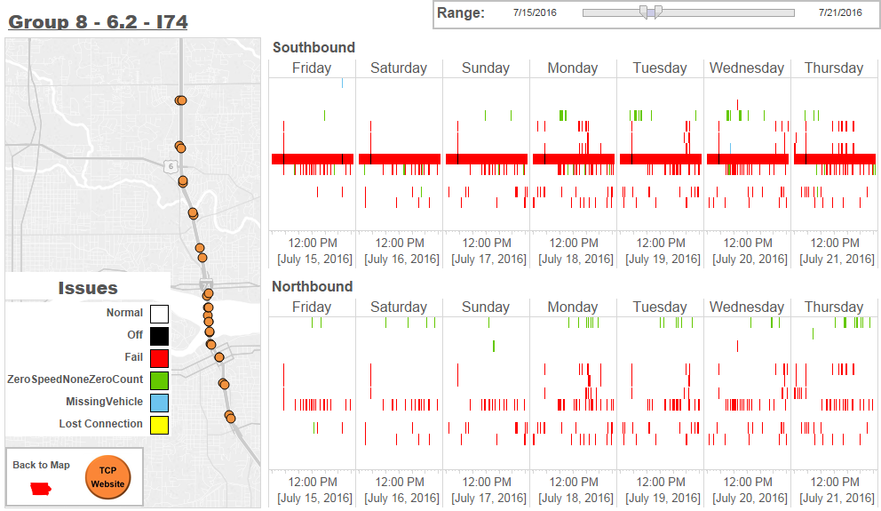
Sensor Monitoring

Slide 17
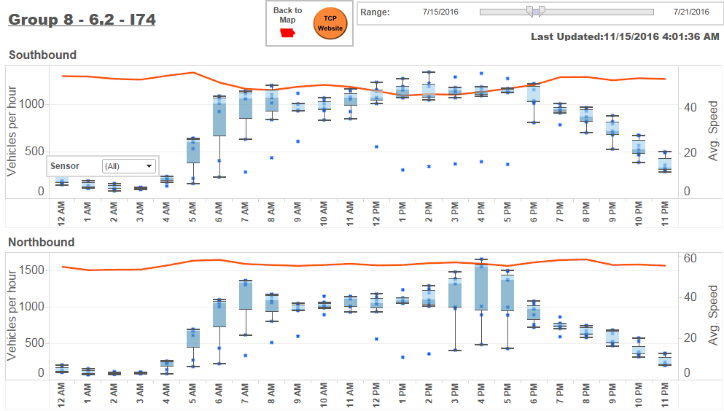
Volume Plot

Slide 18
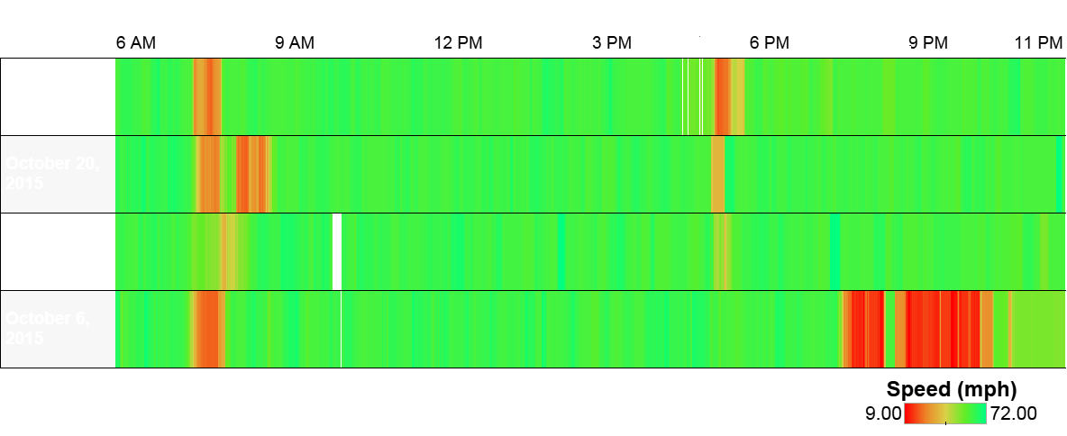
Are traffic incidents outliers?
Incident: Any non-recurring event that causes a reduction of roadway capacity or an abnormal increase in demand.
Time of day
Date
06/14
06/21
Traffic Incident
06/28
07/05

Slide 19
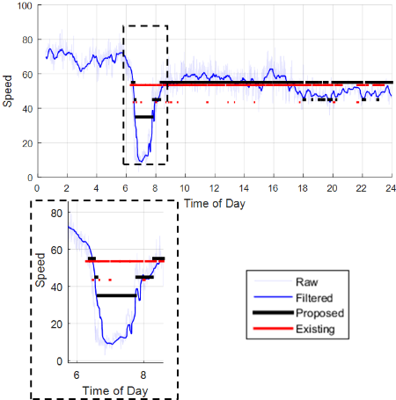
Dynamic Message Signs

Slide 20
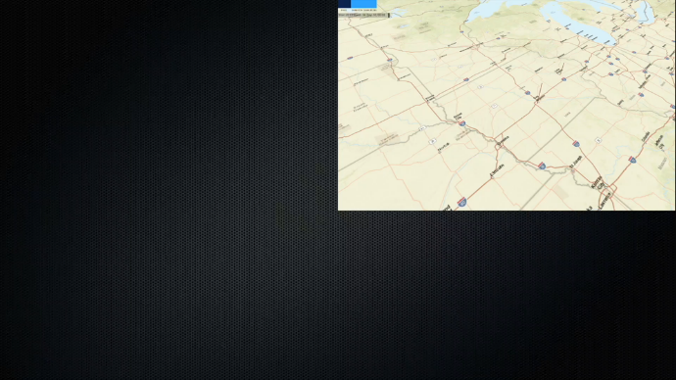
Simple comparative visualization

Slide 21
Applications of Deep Learning in Transportation

Slide 22
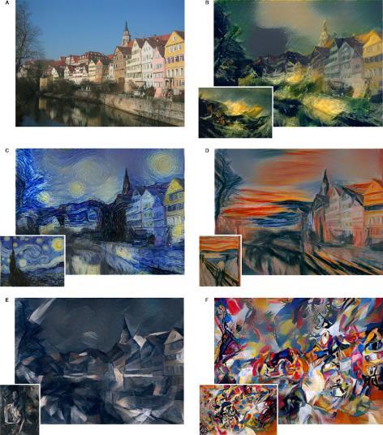
How is Deep Learning Changing Things
Baidu claims that the app's speech recognition is more accurate than actual typing, having developed and tested the technology alongside speech software experts at Stanford University...The researchers concluded that Baidu's technology was three times faster than a typical user typing in English. The results showed that the TalkType error rate was 20.4% lower than an English texter hunting and tapping for letters. The accuracy was even greater for those typing in Mandarin, with the error rate dropping 63.4% when using TalkType.

Slide 23
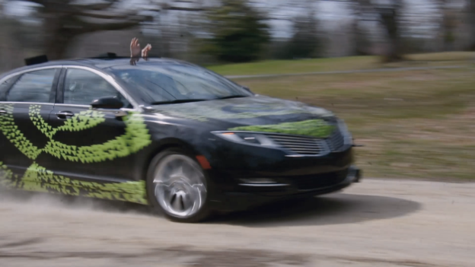
End-to-End Deep Learning for Self-Driving Cars
In a new automotive application, we have used convolutional neural networks (CNNs) to map the raw pixels from a front-facing camera to the steering commands for a self-driving car. This powerful end-to-end approach means that with minimum training data from humans, the system learns to steer, with or without lane markings, on both local roads and highways. The system can also operate in areas with unclear visual guidance such as parking lots or unpaved roads.
We never explicitly trained it to detect, for example, the outline of roads. In contrast to methods using explicit decomposition of the problem, such as lane marking detection, path planning, and control, our end-to-end system optimizes all processing steps simultaneously.

Slide 24
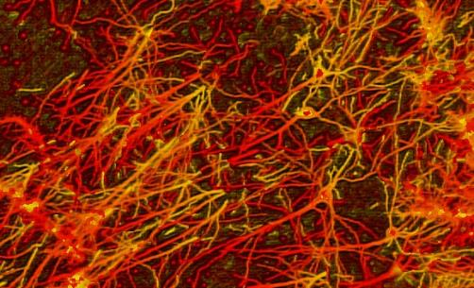
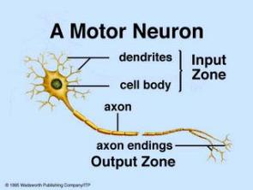
End-to-End Deep Learning for Self-Driving Cars
The human brain contains about 10 billion nerve cells, or neurons. On average, each neuron is connected to other neurons through about 10 000 synapses.

Slide 25
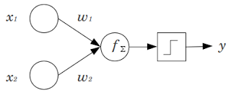
The perceptron computes a weighted sum of the inputs, subtracts a threshold, and passes one of two possible values out as the result.
Unfortunately, the perceptron is limited and was proven as such during the "disillusioned years" in Marvin Minsky and Seymour Papert's 1969 book Perceptrons.

Slide 26
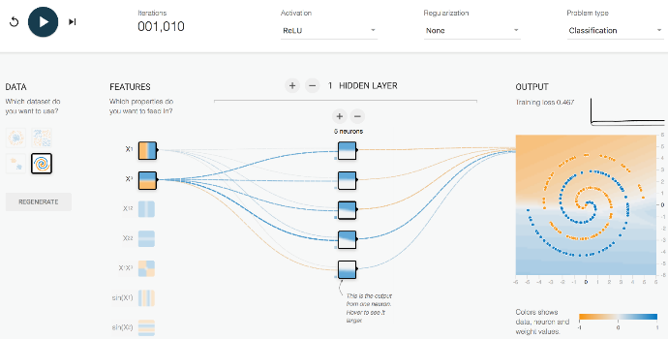
New Vision Solutions
Deep Learning
Use of neural network with multiple hidden layers
Single layer network –classification error 0.46 → 46% misclassification

Slide 27
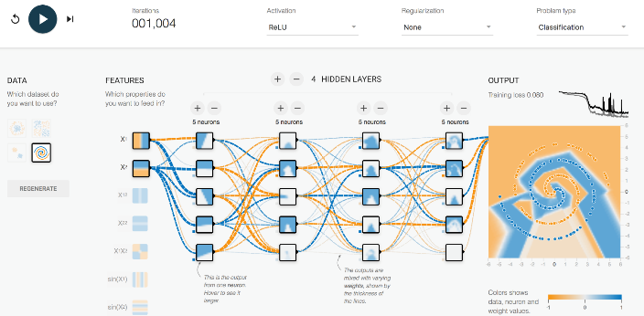
New Vision Solutions
Deep Learning
Use of neural network with multiple hidden layers
Deep layer network –classification error 0.08 → 8% misclassification

Slide 28
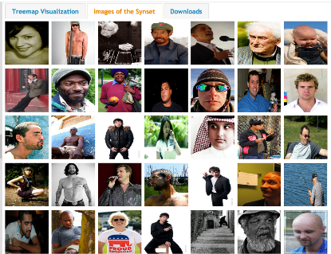
New Vision Solutions (Why now?)
Tough to train
Big sample size for training: Crowd sourcing (google images, facebook ) – Generated massive datasets
Over 14 Million images that are human annotated (ImageNet)

Slide 29
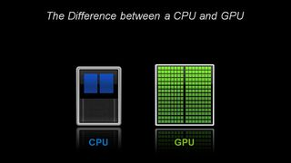
New Vision Solutions (Why now?)
Computation power
GPUs were invented for gaming but have changed history of AI
CPU good for serial computationally heavy operations (few powerful cores)
GPU good for multiple computationally massively parallel computation as needed for training a deep net (100+ cores)
https://blogs.nvidia.com/blog/2009/12/16/whats-the-difference-between-a-cpu-and-a-gpu/

Slide 31
Multi-object Detection – With Poor Video Quality

Slide 32
Video Insert
Video is used only for detection.
Video is not recorded. Only the detections are recorded

Slide 33
Video Insert
Different lighting conditions can be handled easily
Detection region can be marked upfront
The object can be tracked across the region thus signifying static versus moving objects

